Slide 1
Exploring Research Administration from Concept to Commercialization
Research Foundation
Kim Smith, Director, Research Foundation
Sandra Sovinski, Associate General Counsel

Slide 2
AGENDA
Mission and Overview
Account Types
Indirect Costs and Management Fees
Services Offered and Business Processes
Board of Directors
Legal language, Insurance, Liabilities
OVERVIEW

Slide 3
Introduction & overview
Mission
To support the UCF/ORC, faculty, staff, and students, in administering research, commercialization and economic growth by providing high quality administrative, fiscal and support services in a user-friendly and efficient manner.

Slide 4
Introduction & Overview
History
1991 Research Foundation was Founded
2003 Research Foundation was restructured to accept private industry contracts and grants, and contributions

Slide 5
Introduction & Overview
501 (c) 3 Non-Profit
A university affiliated nonprofit corporation providing services to a defined degree to its university’s research program
Defined degree: the scope of services provided varies widely, ranging from providing comprehensive grants and contracts administration and related business services to a more narrowly focused mission, and many variations between the two
Research program: sponsored research from federal, state, private foundations and industry, can also include internally funded programs
Eligible to receive tax deductible contributions
Must be organized and operated exclusively for exempt purposes (research and education)
Provide flexible alternatives to UCF and state processes
Direct Support Organization of UCF (Florida Administrative Code 6C7-4.034)(Florida Statutes 1004.28)

Slide 6
Introduction & Overview
Operations
The Research Foundation is a separate entity from UCF and as such we have our own:
Bank account
Accounting system
Purchasing system
Business manual
Federal employer identification number (EIN) (59-3086453)
DUNS (784933843)
Florida tax exempt certificate
Notes:
Accounting system – receive funds, prepare & submit invoices and other financial reports, accounting records balanced on a monthly basis and reconciled with our bank
Purchasing system – we can issue PO’s, establish store credit, allow colleges and research centers to obtain their own RF credit card or can use the RF’s credit card in many situations. Credit cards are currently held by incubator site managers, CREOL, BSBS. PI’s can make on campus purchases with the computer store, office plus, physical plant, print shop, etc. RF can reimburse employees for acceptable charges when purchases are made with their own funds, RF can reimburse UCF for acceptable charges

Slide 7
RF Account Types
02 TTO Commercialization Projects
03 Licensing /Option Agreement
04 Operating Account
05 Donations/Sponsorships/Other Non-C&G Activity
06 Residual (Balance) Accounts/Royalty Income
07 Contract & Grants
08 UCF Foundation External Funding
09 Incubator Rent Accounts
Notes:
With all account types, the RF uses UCF’s HR system for payroll and tuition. As such, a PeopleSoft account number will be issued, as applicable. Colleges and departments will handle payroll and tuition the standard way. RF reimburses UCF on a quarterly basis for payroll and tuition charges. No action required by the PI or college/department is needed.

Slide 8
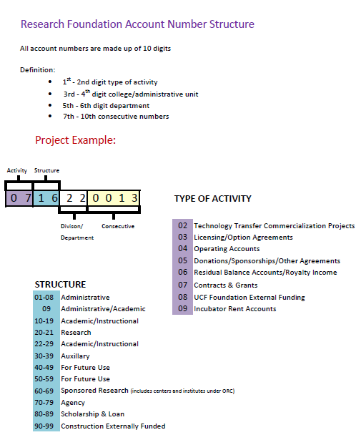
RF Account types

Slide 9
Indirect Rates & Management Fees
UCF’s F&A Rate Agreement (07 Contract & Grants)
46% on campus organized research
30% on campus other sponsored activity
26% off campus all programs
20% optional reduced rate for fixed price (only) when appropriate (46% UCF F&A rate – 26% administrative cap = 20%)
Advance payment by sponsor is required
UCF retains rights to all IP
Minimal administrative requirements (reporting)
Management Fee (02 , 03, 04, 05, 09)
5%
Notes:
The UCFRF’s data is included in UCF’s proposal for Facilities and Administrative cost rates, therefore those rates are applicable to UCFRF C & G activity. These rates are determined in accordance with federal government cost principles and as a result of audit and negotiations between UCF and its cognizant federal agency, the Department of Health and Human Services (DHHS).

Slide 10
Services
Some funding agencies favor making awards to a 501(c)(3)
RF can accept contractual language that UCF cannot
Laws of another state and/or country
Indemnify other party
Provide some flexibility in expense reimbursements (paid on receipts up to $85/day or the $36 per diem)
For fixed price industry awards, there is an optional reduced rate if the award meets the qualifications
RF can pay for refreshments and other items which are difficult or impossible for UCF to pay, if funding agency terms & conditions allow
RF e-mails financial summaries no later than the 10th of the month to PIs & other designated parties
Project records for contracts, grants, and donations can be accessed through ORC’s ARGIS system
Principal Investigators get credit for bringing in research funding for contracts, grants, and support, just as they would if the project were run through UCF/ORC

Slide 11
Services
Fiscal Year Issues
No long dead periods between fiscal years
(UCF April/May – Aug/Sept)
Purchasing/Contracting
Streamlined bid processes enable expedited receipt of equipment & supplies
Ability to enter into multi-year contracts such as with equipment or vehicle leases
PI’s can make purchases on their own, and be reimbursed later; or they can work with the RF to place and pay for the order
Intellectual Property Management
Own & license intellectual property
Can take an equity position in a start-up company; ability to sell an equity position in a start-up company
Can buy & sell equities (stocks)
Real Property Management
Can buy & sell real estate
Can sign/take out a mortgage
Can be the lender on a mortgage
Can manage real estate and lease to commercial tenants

Slide 12
Business processes
Responsibilities for C&G Activity Set-up through the RF
Proposals & Contract Management Teams
(same responsibilities as if set up through ORC)
Proposal review and appropriate F&A rate determination
Charge full UCF F&A rate. The RF is included in UCF’s F&A Rate Proposal.
Proposal submission
Negotiation of award
Obtain signature of RF President, VP, or designee on award docs
No cost extensions and budget change requests
Pre-expenditure review
(PLEASE NOTE: All 07 accounts are to be managed according to the cost principles outlined in OMB A21)
Research Foundation
Review and approve expenditures
Financial reporting and invoicing
Financial closeout

Slide 13
Audit & Reporting
The RF accounting records are audited annually by an independent audit agency.
The RF files an annual 990 with the IRS and issues 1099s to independent contractors per IRS regulations.
The RF files an annual report with the State of Florida Division of Corporations and copies UCF’s General Counsel.
Copies of audits are provided to:
Finance & Accounting
University Audit
UCF Board of Trustees
State of Florida Board of Education
LOTS of OVERSIGHT!!

Slide 14
Organizational structure
Board of Directors (12 Directors & Officers)
President – Dr. MJ Soileau
Vice President – Dr. Tom O’Neal
UCF’s President – Dr. Hitt
Required by Statute to be on RF Board
The Chair of the UCF Board of Trustees,
by statute, may appoint a member to the UCFRF Board
Treasurer – Ed Jacobs
Secretary – Kim Smith
Notes:
Directors are made up of local business officials. Bill Merck VP of Admin and Finance and CFO for UCF is a Director.

Slide 15
Organizational structure
Director/Chief Operating Officer Chief Financial Officer
Kim Smith, 407-823-3062 Edward Jacobs, 407-882-1113
kim@ucf.edu edward.jacobs@ucf.edu
Administrative Liaison ORC Coordinator of Accounting
Chris Dantes, 407-882-1124 Mieraf Tadesse, 407-823-0521
Chris.dantes@ucf.edu mieraf.tadesse@ucf.edu
Coordinator, Research & Program Services
Hilary Hitchner, 407-882-0097
Hilary.hitchner@ucf.edu
Coordinator, Research & Program Services
Nita Patel, 407-823-3458
Nivedita.Patel@ucf.edu
Research Foundation Assistant
Elizabeth Hughes, 407-882-0190
Elizabeth.Hughes@ucf.edu

